Slide 1
Welcome to
Alpha Kappa Alpha Sorority, Incorporated
The GaMma Nu Omega Chapter
AND
The Pink and green community service foundation, incorporated
Presents….
2019
Scholarship Recipients
Recognition Program
Sunday, June 23, 2019
Four o’clock in the Afternoon
Brookland Baptist Church Northeast
1203 Summit Parkway, Columbia, SC 29229

Slide 2
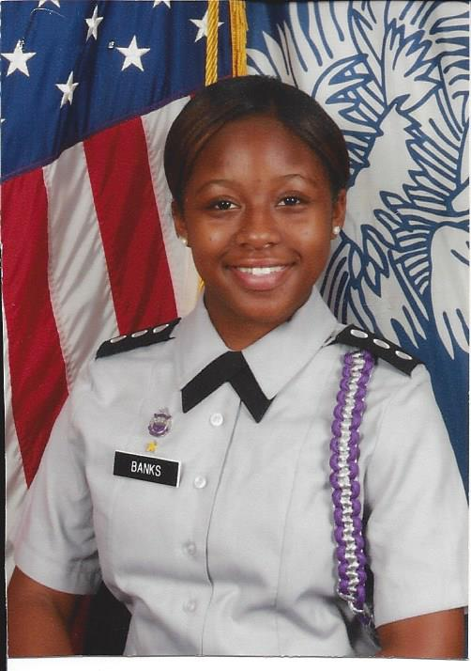
Amaya Banks
Ridge View High School

Slide 3
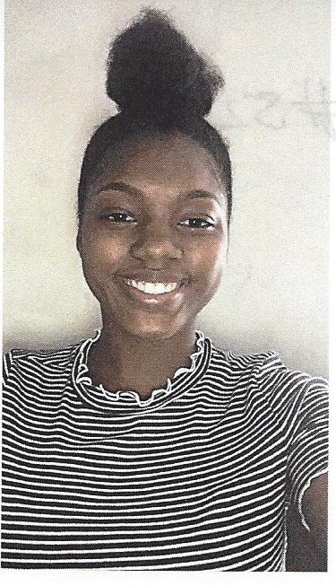
Synovia Bell
Blythewood High School

Slide 4
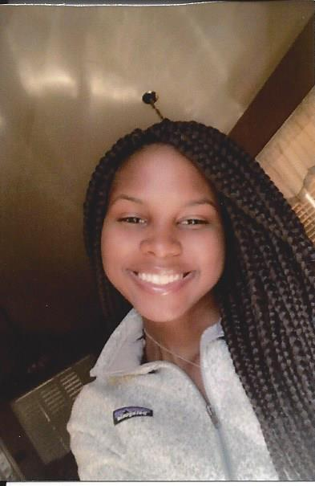
Tymia Boles
Dreher High School

Slide 5
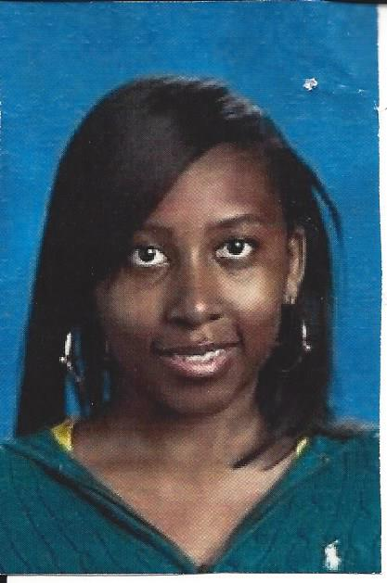
Jaylynn Brantley
Eau Claire High School
19

Slide 6
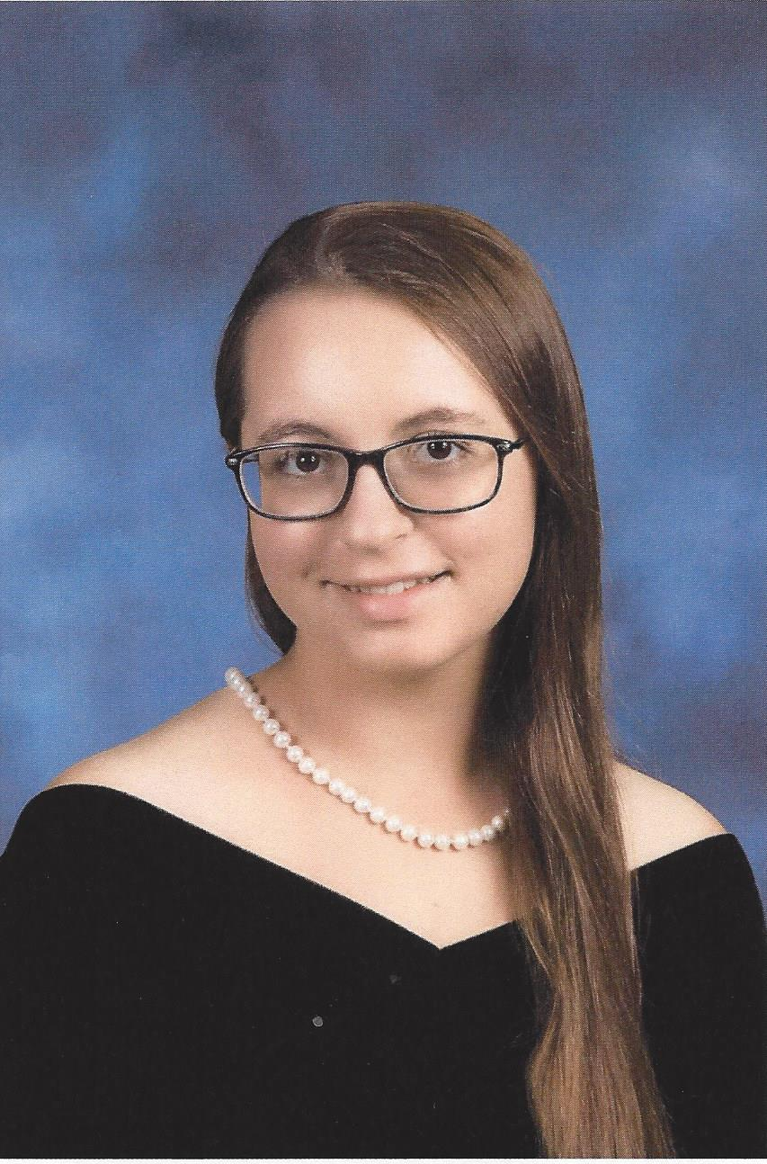
Marie Burns
Blythewood High School

Slide 7
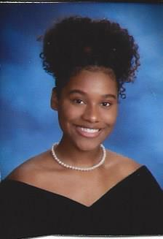
Asyah Caldwell
Spring Valley High School

Slide 8
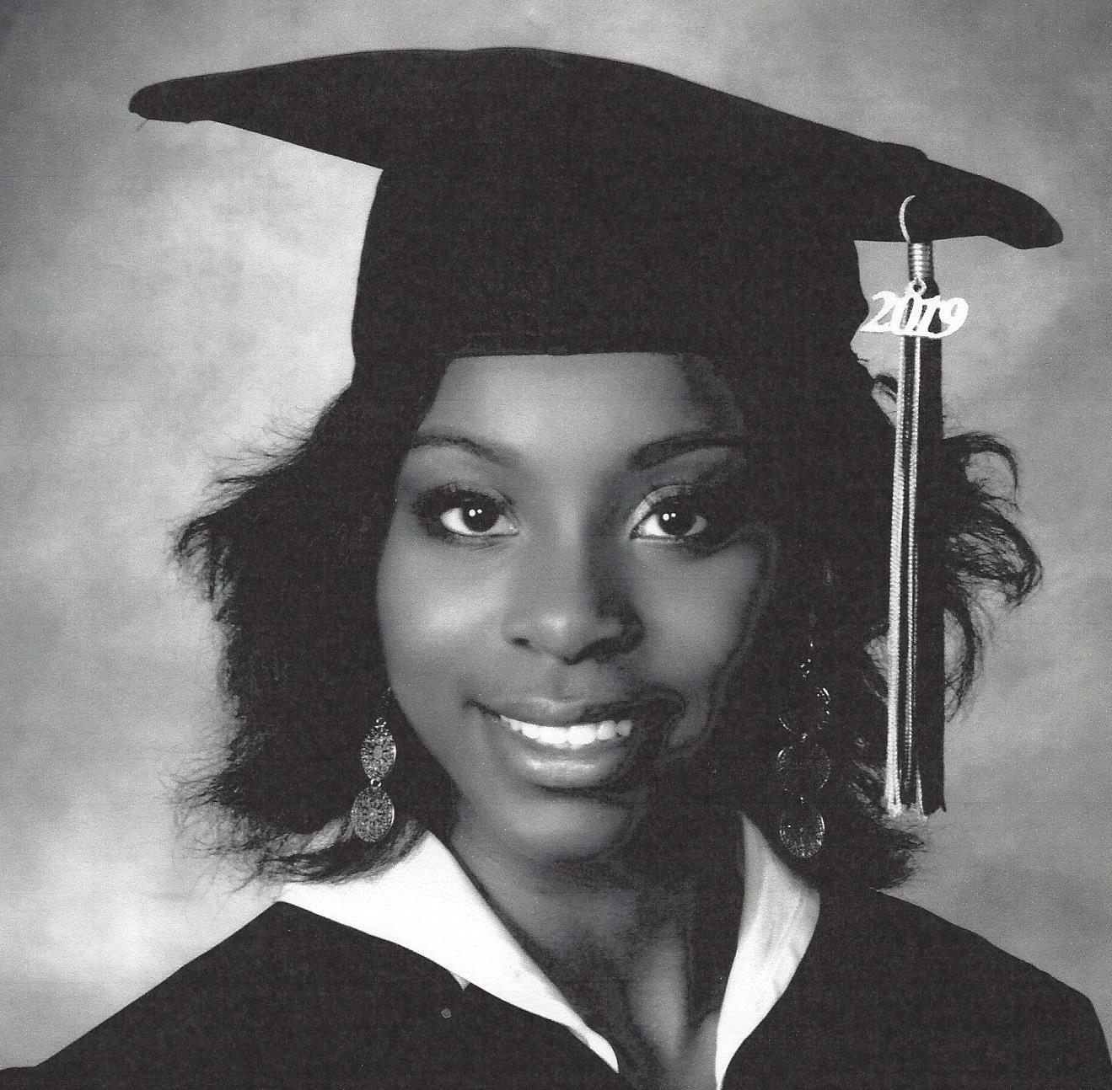
Breonna Calhoun
Lower Richland High School

Slide 9
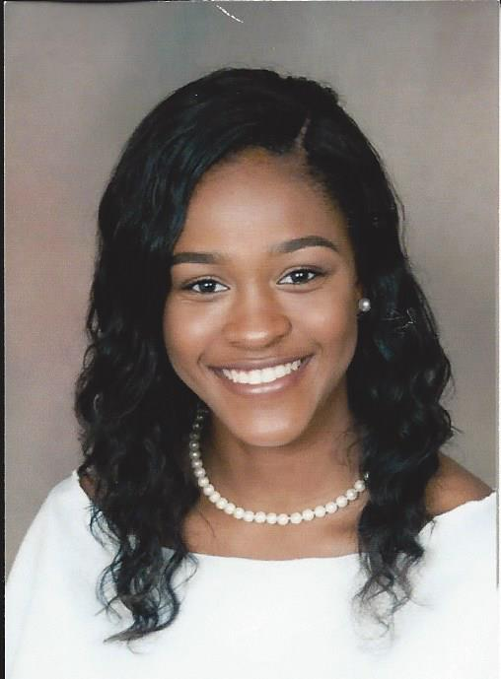
Kira Chiles
Blythewood High School

Slide 10
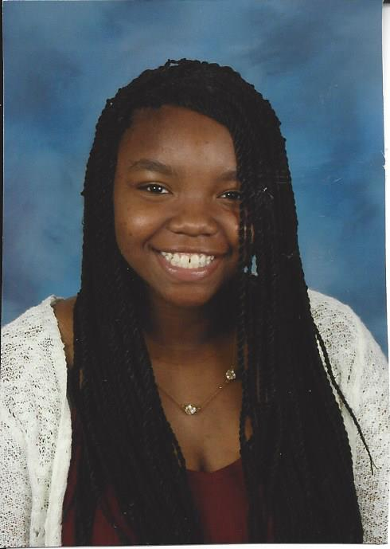
Christal Coard
W J Keenan High School

Slide 11
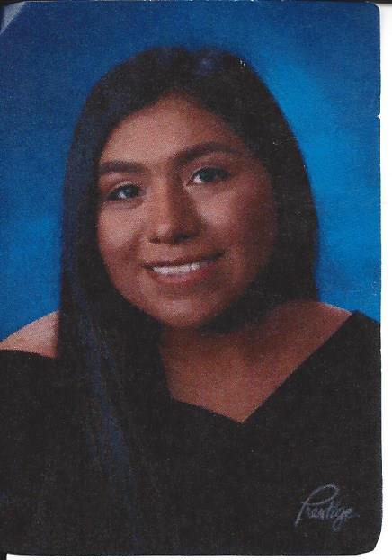
Abigail Daniel-Perez
Westwood High School

Slide 12
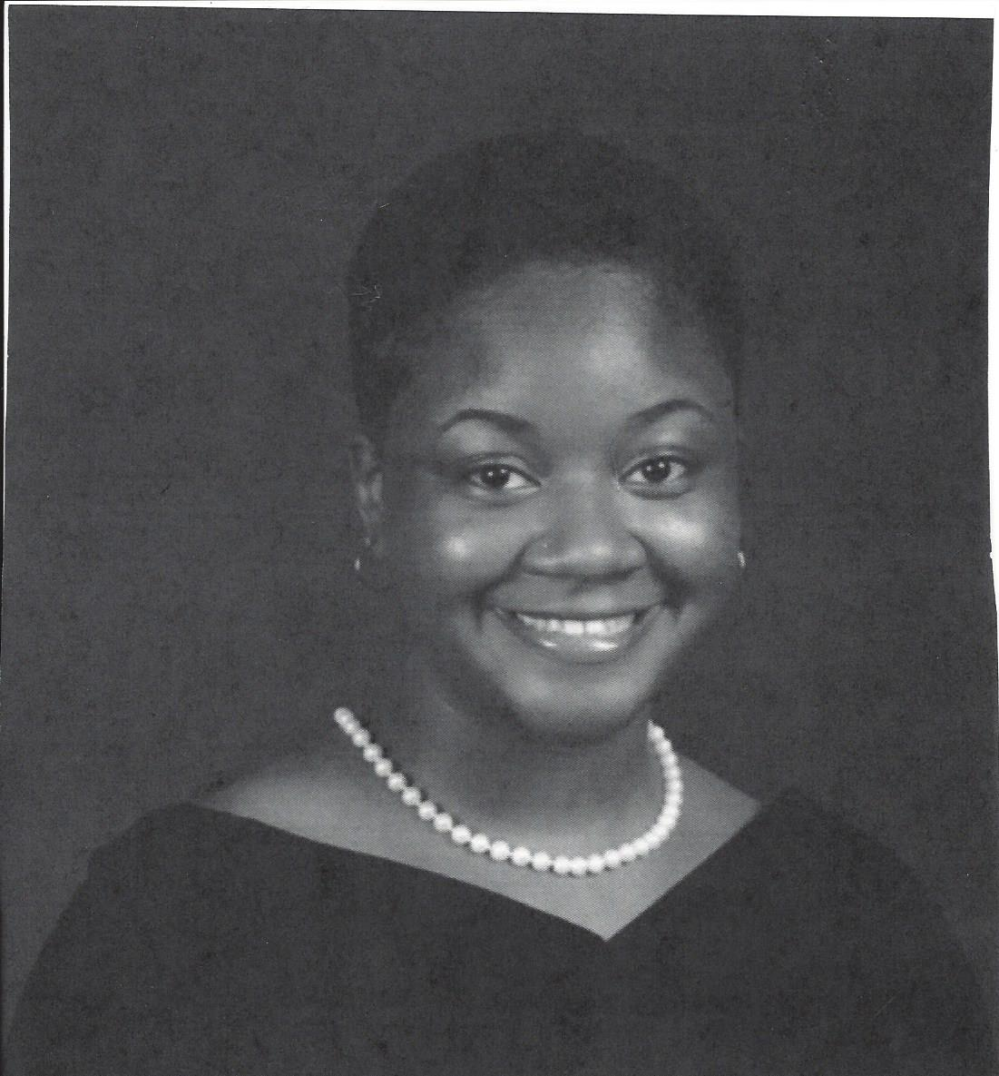
Deborah Dixon
Irmo High School

Slide 13
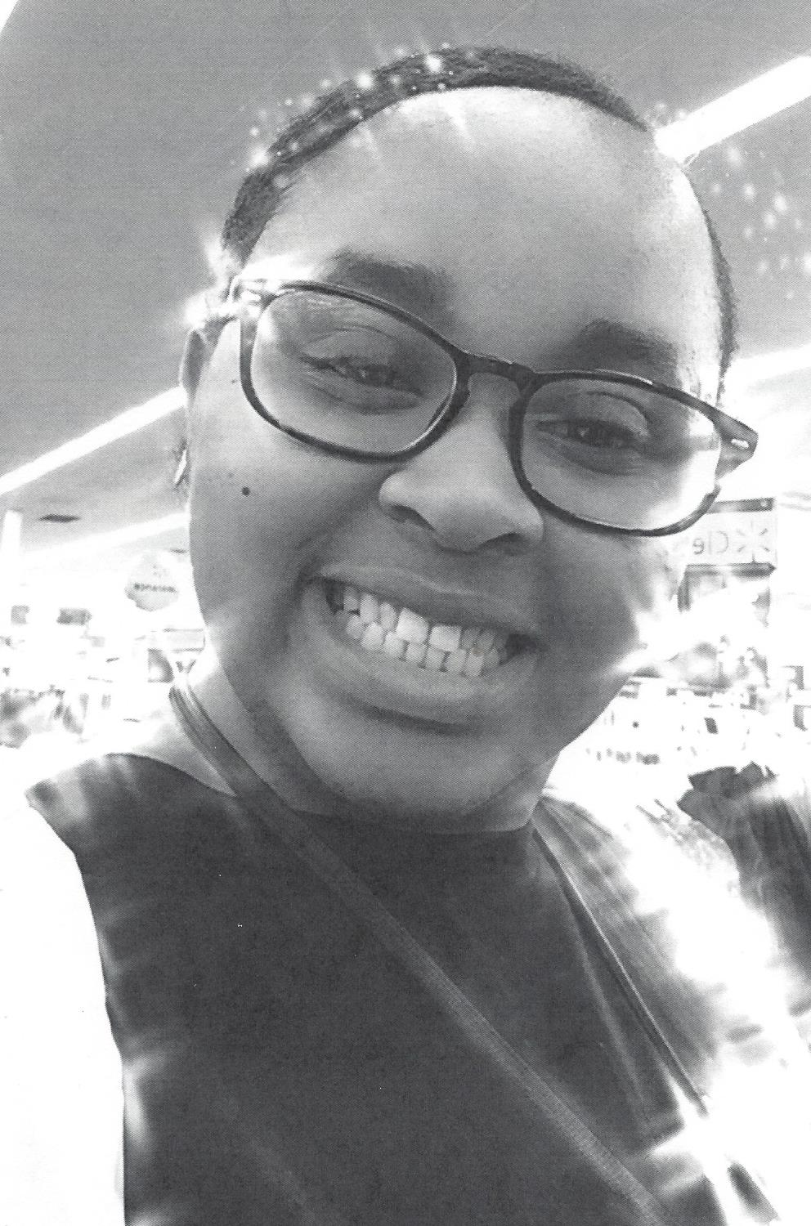
Atashanay Eskridge
Irmo High School

Slide 14
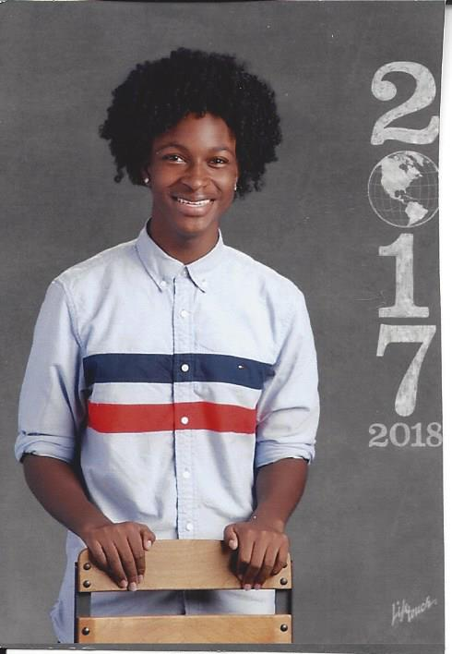
Darius Free
Fairfield Central High School

Slide 15
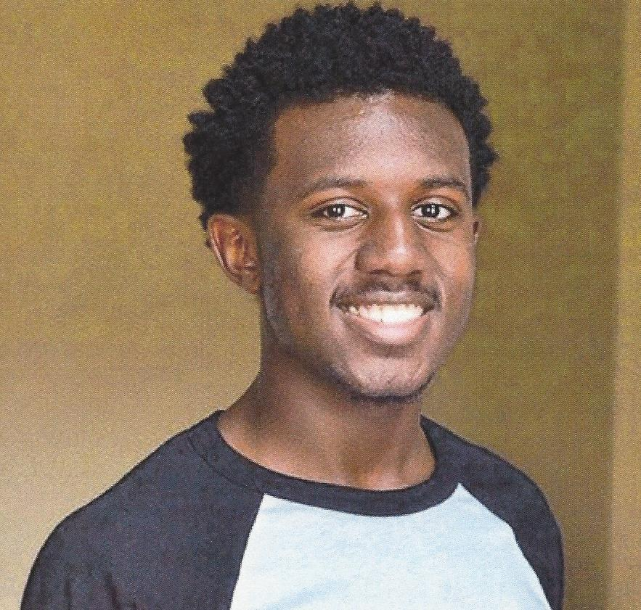
Nyles Geiger
Blythewood High School

Slide 16
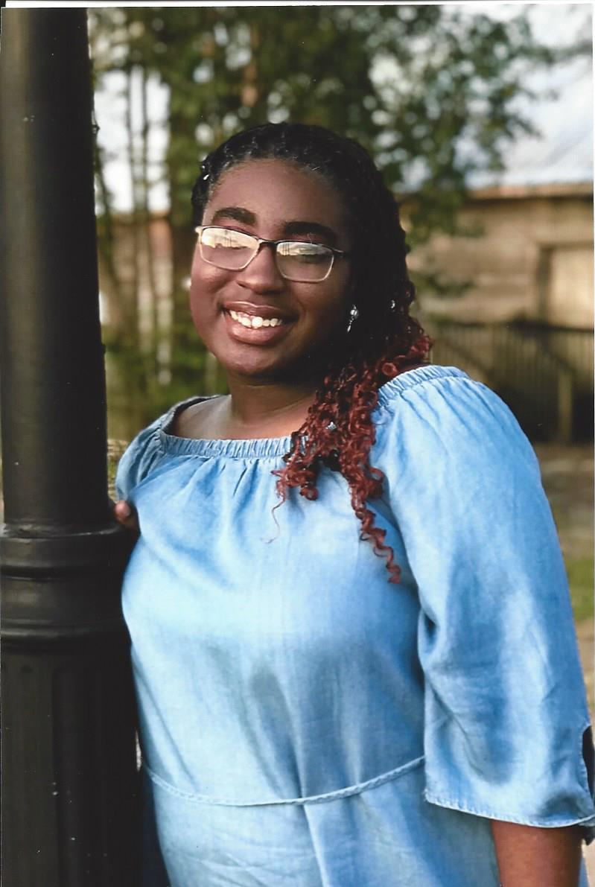
NaZaria Gerald
White Knoll High School

Slide 17
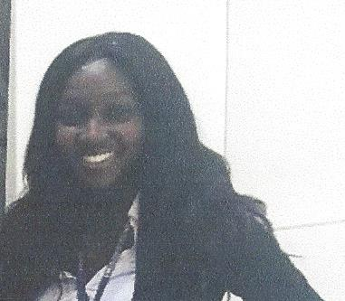
Jamara Green
Fairfield Central High School

Slide 18
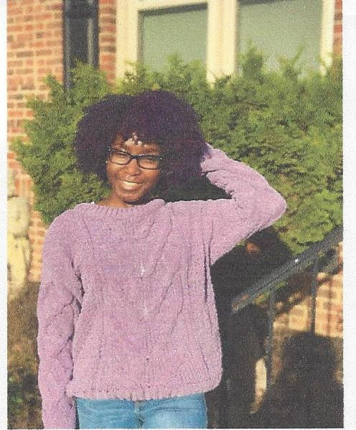
Janelle Green
Fairfield Central High School

Slide 19
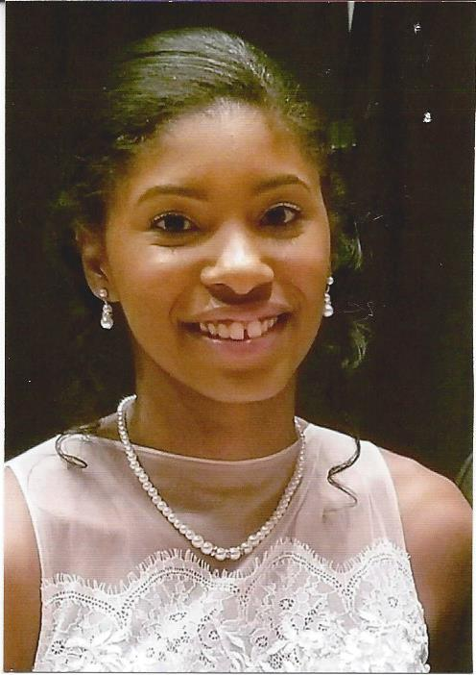
Jordan Green
Spring Hill High School

Slide 20
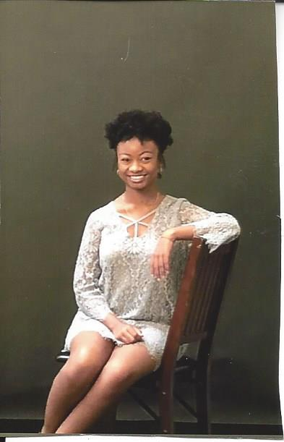
Caleena Greene
Spring Valley High School

Slide 21
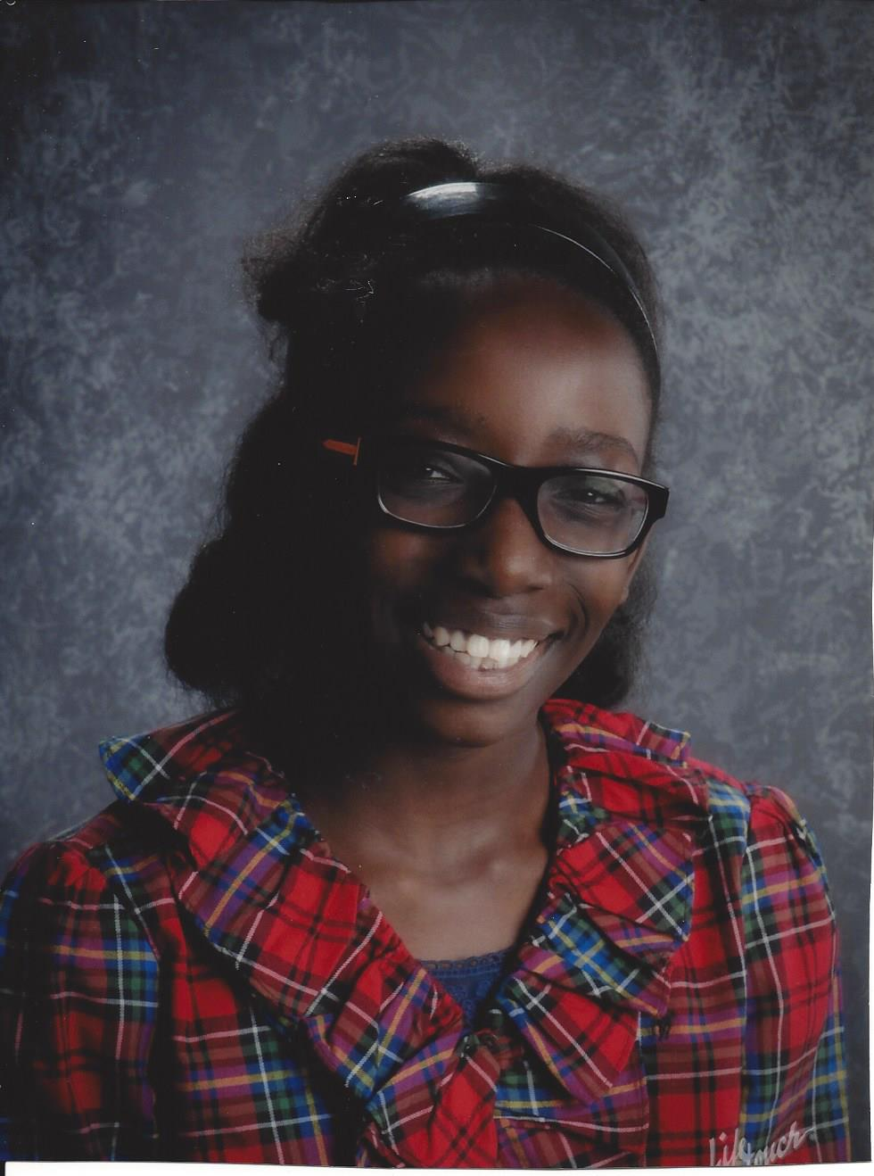
Sydney Hannibal
Spring Valley High School

Slide 22
Miranda Hurt
Ridge View High School

Slide 23
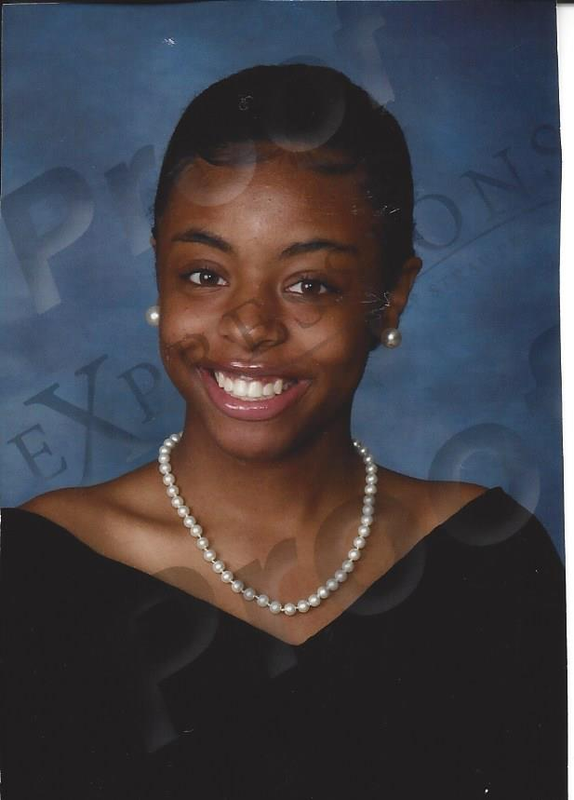
Kamryn Jones
Ridge View High School

Slide 24
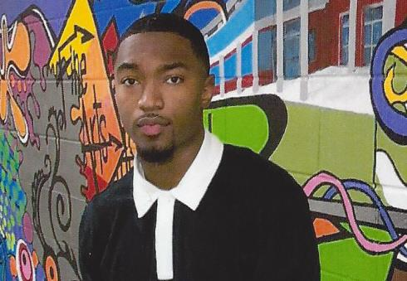
Julian Jordan
Blythewood High School

Slide 25
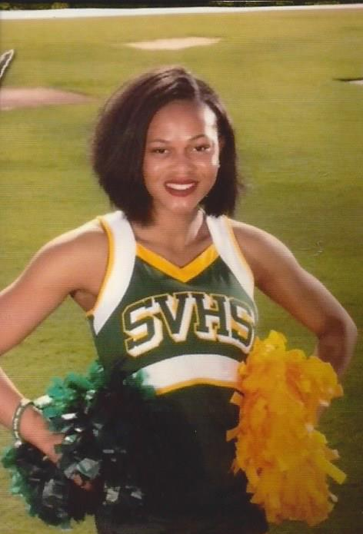
Kyrie Lanham
Spring Valley High School

Slide 26
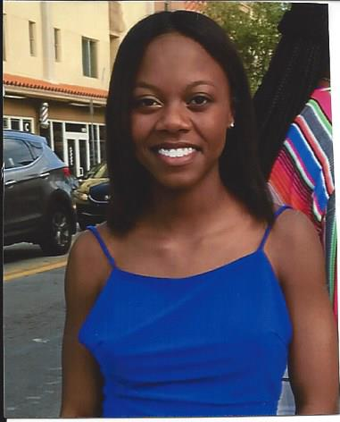
Eliza Leslie
Dutch Fork High School

Slide 27
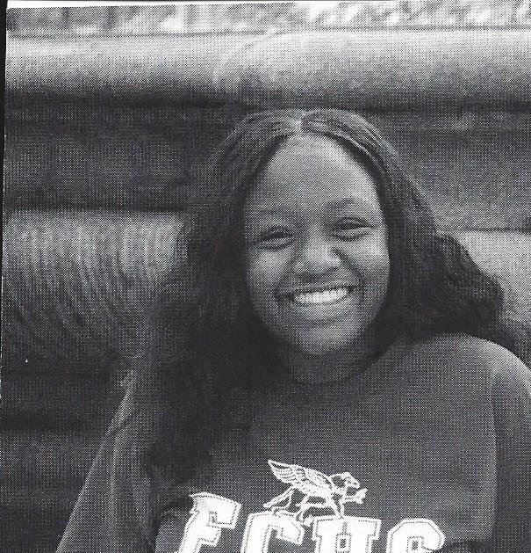
Nhandi Long-Shipman
Fairfield Central High School

Slide 28
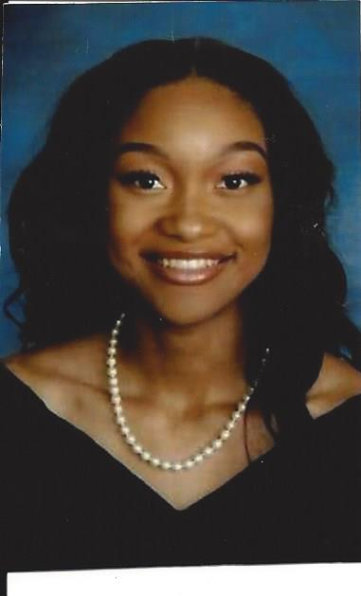
Essence Marshall
Westwood High School

Slide 29
Jordan McDowell
Blythewood High School

Slide 30
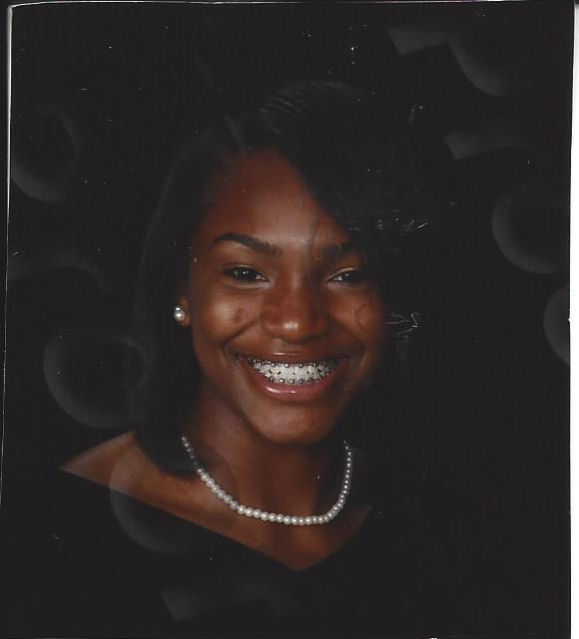
Gabrielle McKinzie
Ridge View High School

Slide 31
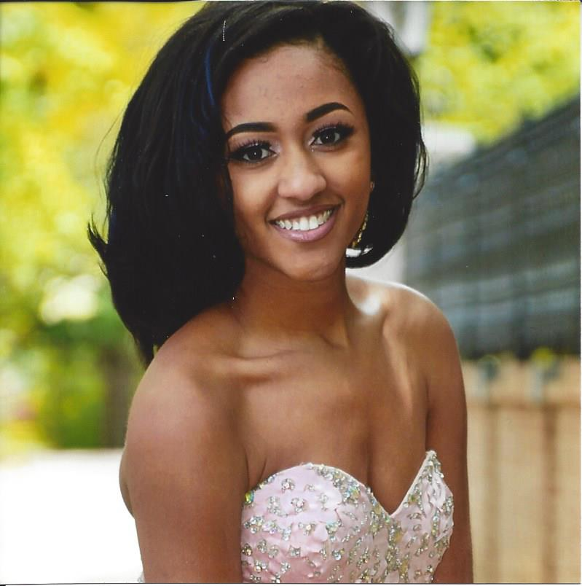
Morgan M Miller
Spring Valley High School

Slide 32
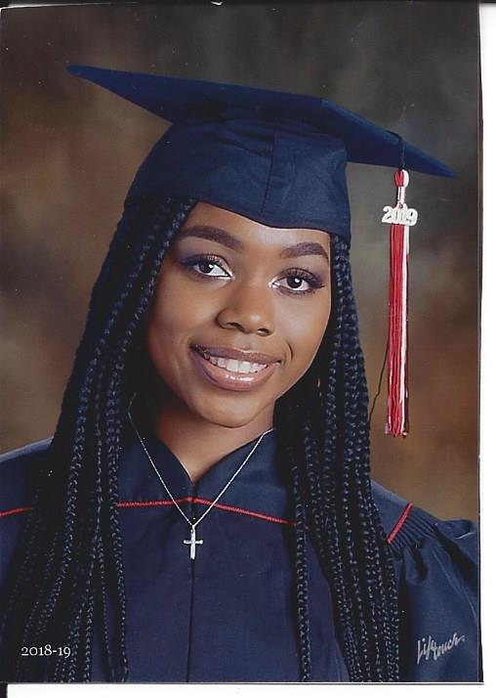
Morgan S Miller
Westwood High School

Slide 33
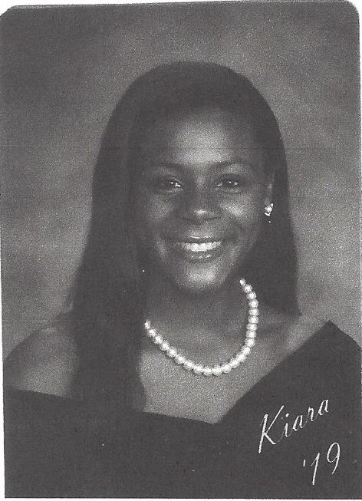
Kiara Myers
Ridge View High School

Slide 34
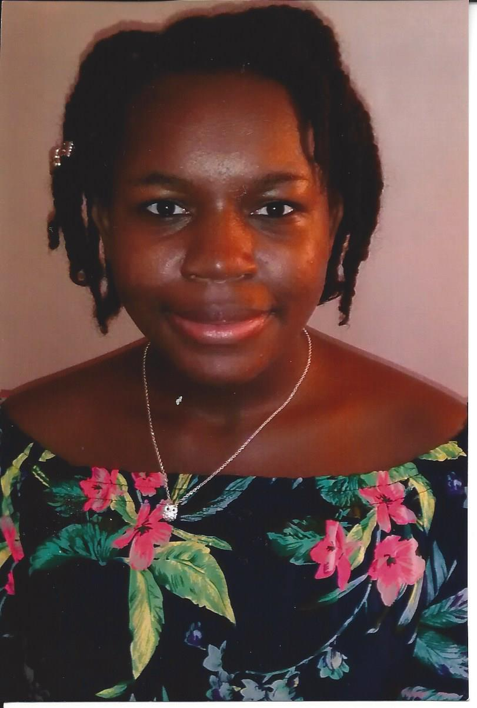
Jazmin Perry
Airport High School

Slide 35
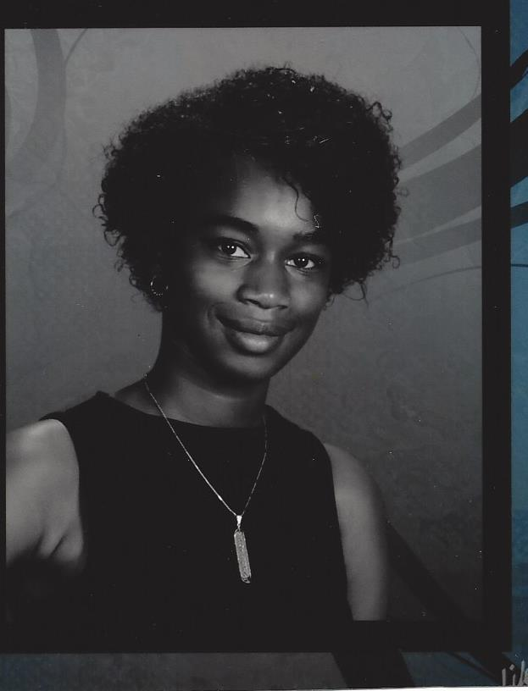
Kadiedra Porter
Ridge View High School

Slide 36
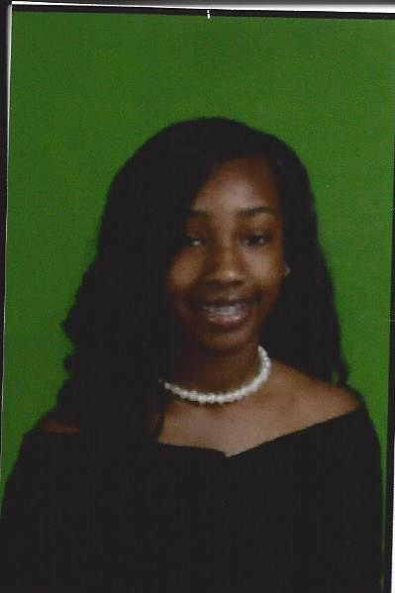
Saibriyya Pou
Airport High School

Slide 37
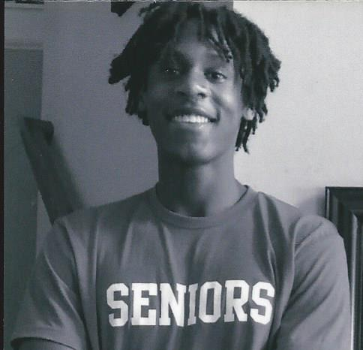
Chase Raymond
Spring Hill High School

Slide 38
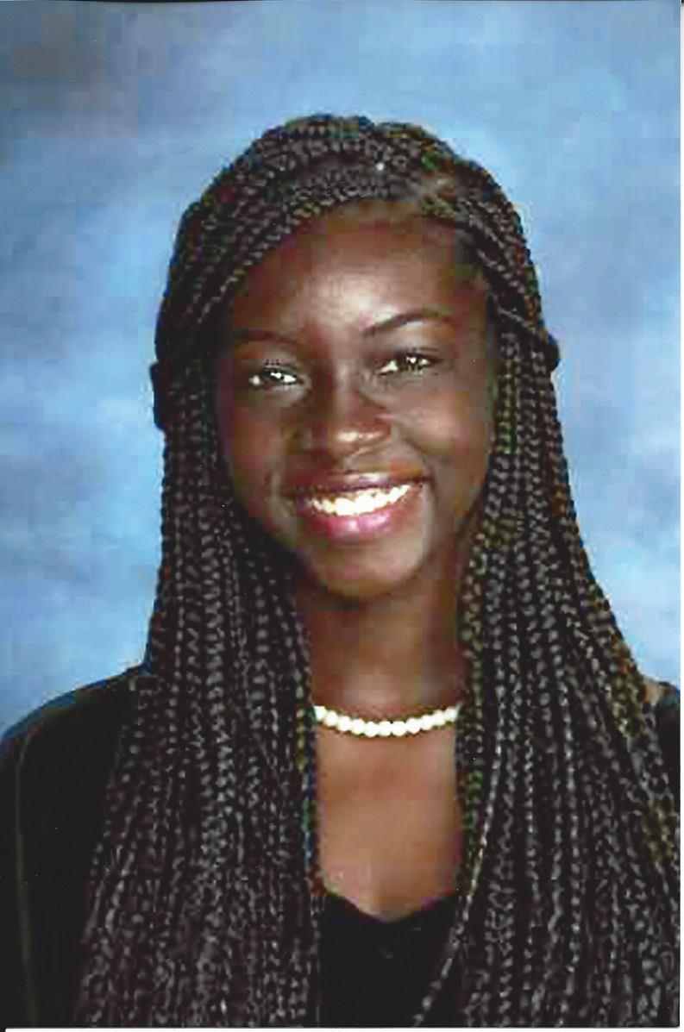
Makeenie Robinson
Ridge View High School

Slide 39
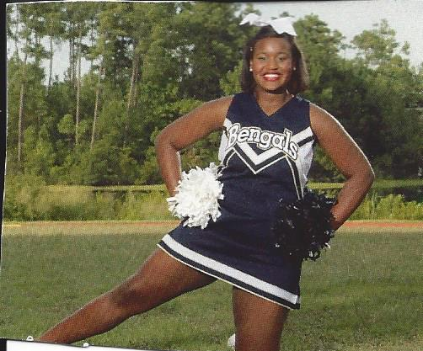
Savannah Rogers
Blythewood High School

Slide 40
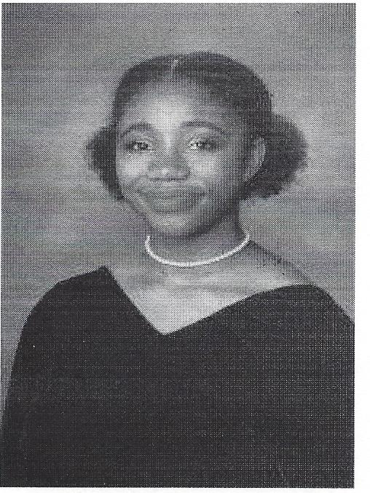
Aya Rose
Richland Northeast High School

Slide 41
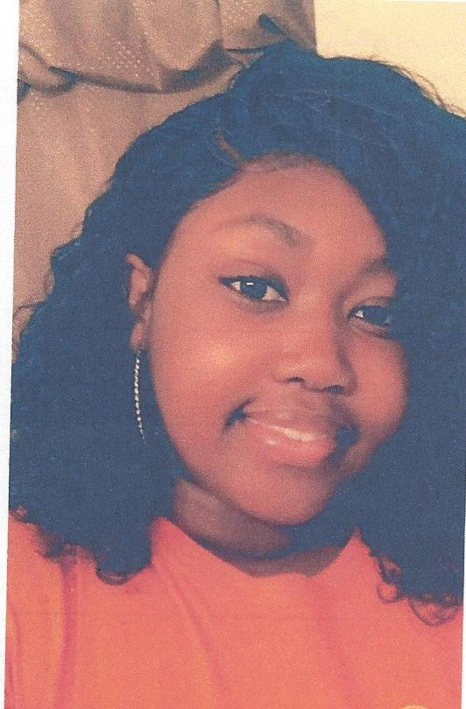
Jasmine Rose
Richland One Middle College

Slide 42
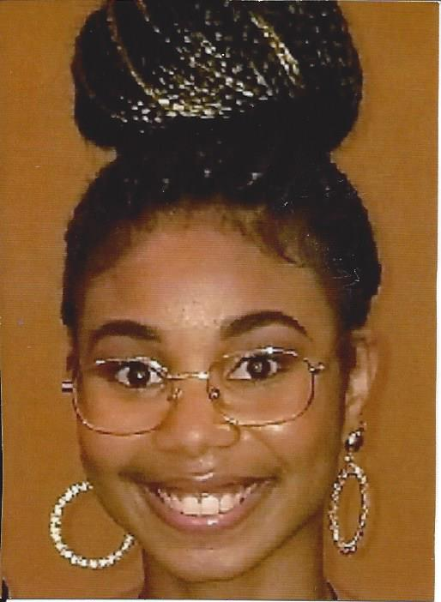
Ra'gin Slater
Irmo High School

Slide 43
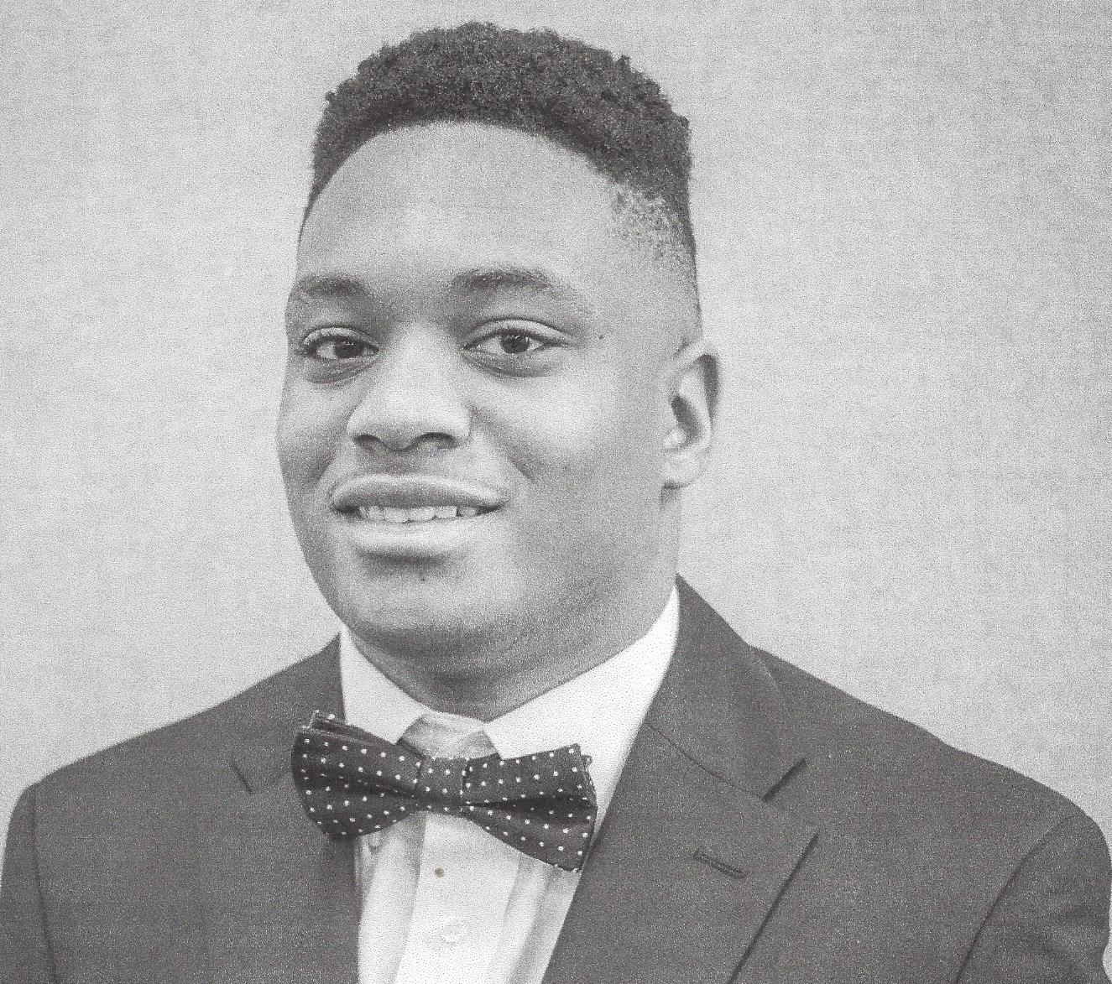
Reginald Smiley
Spring Hill High School

Slide 44
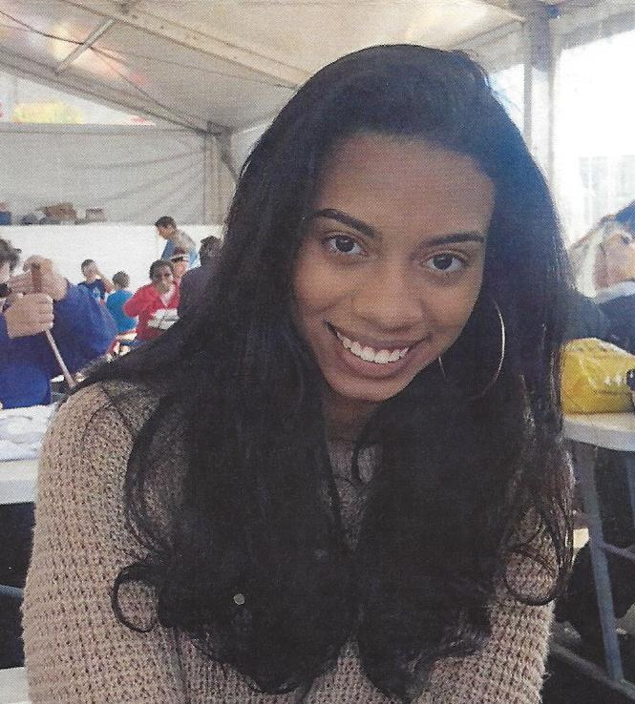
Victoriana Smith
Irmo High School

Slide 45
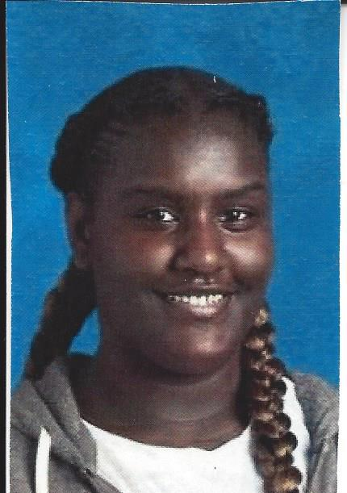
Santasia Smith
Eau Claire High School

Slide 46
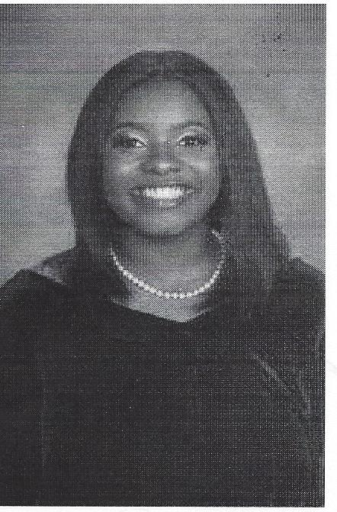
Lo'Ren Suber
Richland Northeast High School

Slide 47
Anaiah Thompson
Blythewood High School

Slide 48
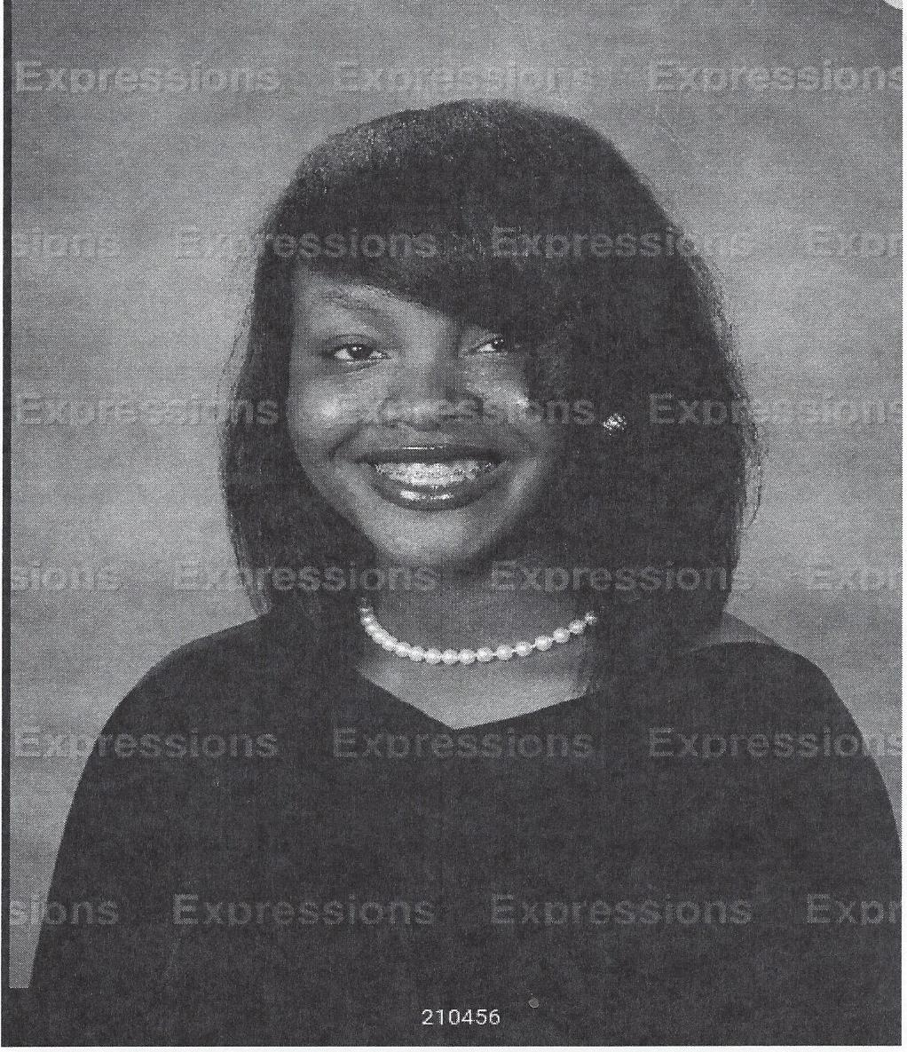
Faith Thompson
Ridge View High School

Slide 49
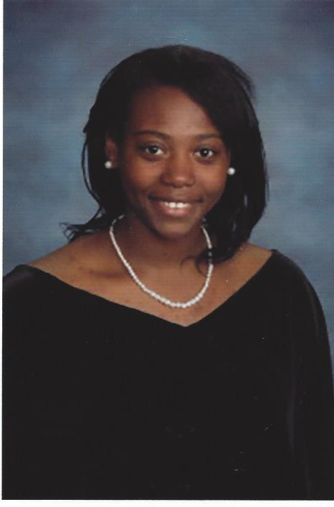
Otiana Thompson
Ridge View High School

Slide 50
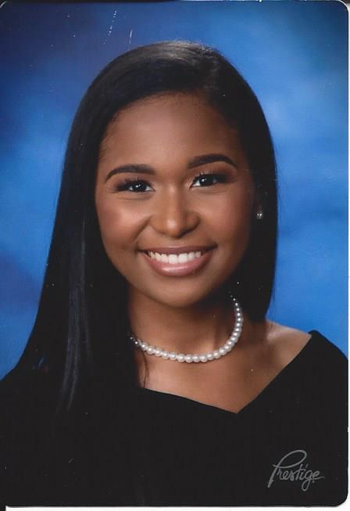
Delaney Toomer
Spring Valley High School

Slide 51
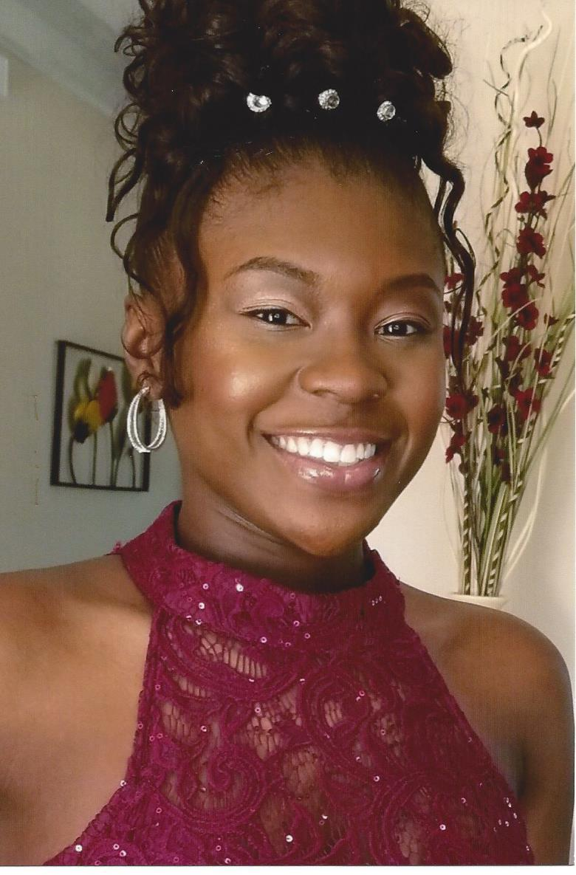
Clarissa Wallace
Dutch Fork High School

Slide 52
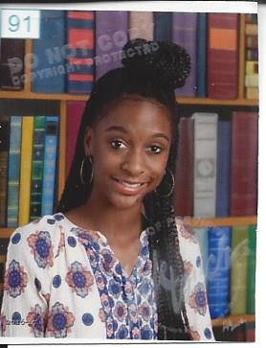
Taylor Williams
Spring Valley High School

Slide 53
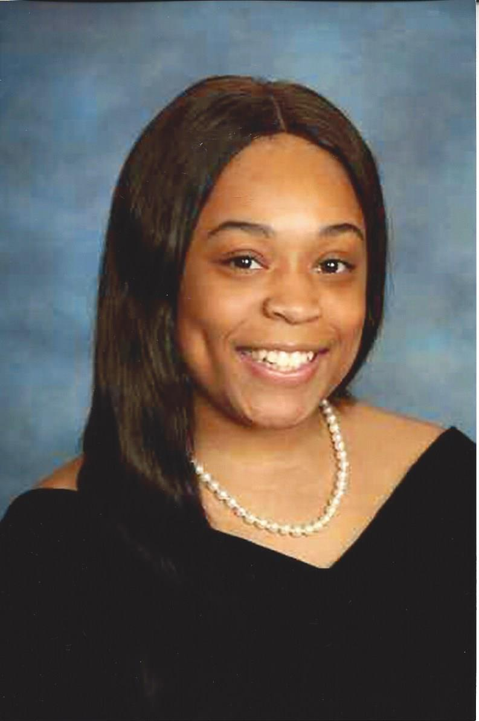
Lauren Wilson
Ridge View High School

